Slide 1
TM354 Block 1
Chris Thomson c.d.thomson@open.ac.uk

Slide 2
Plan
Get to know each other a little more
Discuss key aspects of the first 3 units
Get an overview of the topics covered in the first 3 units
Look at how we begin to model software
Make sure you get the primers from the tutor group forum, and annotate them as we go along!

Slide 3
What is good software?
Use the tools to add words and phrases to this slide that for you define good software

Slide 4
Unit 1: Maintainability
Legacy Systems
are large;
are critical to the business;
have been changed a number of times since their inception;
are difficult to understand because of either a lack of documentation about their internal structure or a lack of experience within the group responsible for them;
are difficult to maintain because of the above factors.

Slide 5
Unit 2: Decomposition
There is a limit to how much we can take in and understand at any one time
We can decompose a problem into smaller and smaller parts or chunks until each one can be comprehended or dealt with by an individual.
We will expose some form of hierarchy in our attempt to simplify a complex system.

Slide 6
Unit 1: Interfaces
The interface to a module defines how other modules can use that module
From an object-oriented point of view, we say that the interface to the class Date is an encapsulation of what we know about Date.

Slide 7
Unit 1: Abstraction
is a particular way of viewing a complex problem to arrive at some useful decomposition of that problem.

Slide 8
Unit 1: Coupling
The degree of interdependence among the different components of a system.
A depends on module B, which depends on module C
Sometimes this is circular.

Slide 9
Unit 1: Cohesion
is a way of describing how closely the activities within a single module are related to each other.
A highly cohesive module performs one task or achieves a single objective: ‘do one thing and do it well’ is a useful motto to apply.

Slide 10
Unit 1: Architecture
The term architecture, in software development, is associated with the overall structure of a software system or, at a higher level, a family of software systems.

Slide 11
Unit 1: Software development processes
A development process is a set of rules that define how a software development project should be carried out.
The identification of a set of software engineering activities associated with the development of software is the key to meeting the potential diversity of users’ needs.

Slide 12
Discussion: Plan driven vs Agile
What experience do you have?
As a user?
As a developer?
As a citizen?
Some starter questions:
What do you think drives software development?
What problems do developers face?
How do developers deliver a product?

Slide 13
Unit 1: Traceability
The ability to trace the history of each requirement is known as traceability. Among other things, traceability is essential for dispute resolution (knowing what was agreed during a project), for seeing the effect, later in the project, of changing or deleting requirements, and for demonstrating that you have dealt with each requirement.

Slide 14
Unit 1: Modeling
In terms of the development of software systems, models are:
a way of understanding the problems involved;
an aid to communication among those involved, especially between the developer and the user, as part of some deliverable;
a component of the methods used in development activities such as analysis and design.

Slide 15
Unit 4: The case study
Examples shown in a more integrated way
Read along side the units to see how a complete problem is tackled.

Slide 16
Discussion: Defining software
What is the basis that we can use to describe software?
What is the relationship between stakeholders and the proposed software?

Slide 17
Unit 2: Functional Requirements
specifications of the product’s functionality;
actions that the product must take – check, calculate, record, retrieve etc.;
derived from the fundamental purpose of the product;
not a quality – for example, ‘fast’ is a quality, and is therefore a non-functional requirement.

Slide 18
Unit 2: Non-functional requirements
look-and-feel requirements – the spirit of the product’s appearance;
usability requirements – the product’s ease of use, and any special usability considerations;
performance requirements – how fast, how safe and how accurate the functionality must be;
operational requirements – the operating environment of the product, and what considerations must be made for this environment;
maintainability and portability requirements – expected changes, and the time allowed to make them;
security requirements – the security and confidentiality of the product;
cultural and political requirements – special requirements that come about
because of the people involved in the product’s development and operation;
legal requirements – the laws and standards that apply to the product.

Slide 19
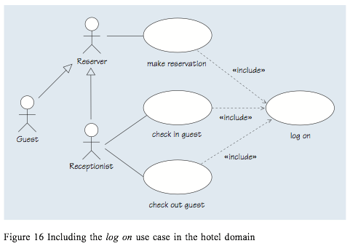
Unit 3: Use case diagram

Slide 20
Self check: Use case diagrams
What is generalization, when might we want to use it and why?
What are includes and extends, when might we want to use them and why?

Slide 21
Discussion
How can use case analysis be made agile?

Slide 22
Unit 3: Use Case Scenario
Identifier and name: UC2 cancel reservation Initiator: Receptionist or Reserver
Goal: A guest’s reservation of a room at a hotel is cancelled. Precondition: There is an active reservation (in the future and not cancelled) for a room at a hotel for a guest with a reservation number.
Postcondition: The reservation will have been cancelled, the allocated room will be freed, and a charge to the credit card will have been made if the cancellation was initiated within 24 hours of the start of the reservation.
Assumptions: The expected initiator is a receptionist or reserver. Main success scenario
1 The receptionist/reserver requests the cancellation of a reservation.
2 The receptionist/reserver enters the reservation number, or the dates, name and address.
3 The hotel system retrieves the corresponding reservation.
4 The hotel system frees the allocated room.
5 The receptionist/reserver confirms the cancellation.
6 The reservation is cancelled, and the hotel system informs the receptionist/reserver of the cancellation.
Extensions
6.a.1 If the cancellation was initiated within 24 hours of the beginning of the reservation, the hotel system charges the credit card whose details are kept in the reservation.

Slide 23
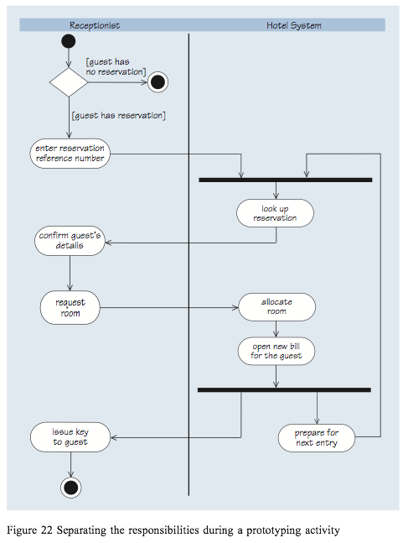
Unit 3: Activity Diagram

Slide 25
Self check: activity diagrams
What is the difference between decision nodes and synchronization bars?
What is a swim lane?
What is a guard?

Slide 26
Next tutorial
Work though TMA style questions as a group.
Identify common errors that students make.

